Slide 1
Commute times in the US and its effects

Slide 2
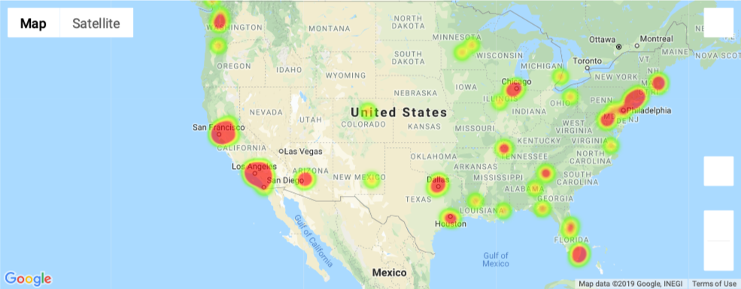
What are the cities or areas in the US with longer commute times?

Slide 3
What are the correlations between commute times income and quality of life in 2017?

Slide 4
Was there a change or noticeable trend when comparing data with the previous 4 years?

